Slide 1

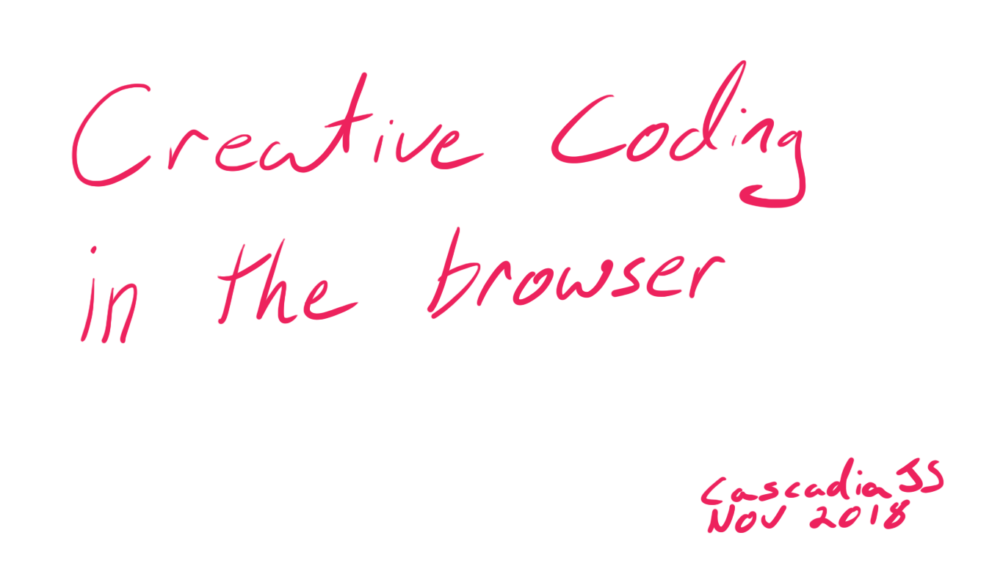
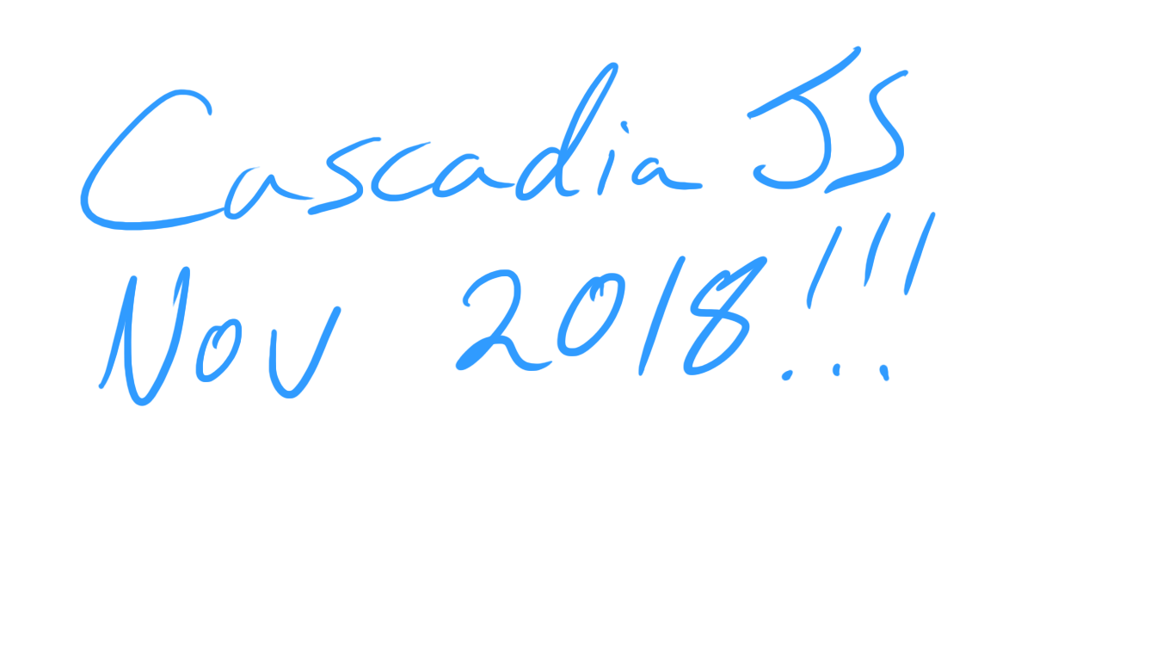
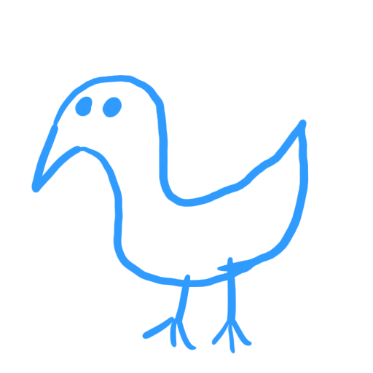
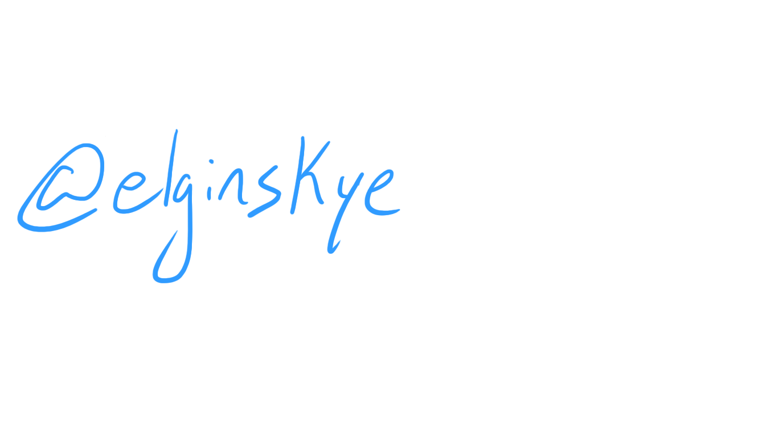

Slide 2
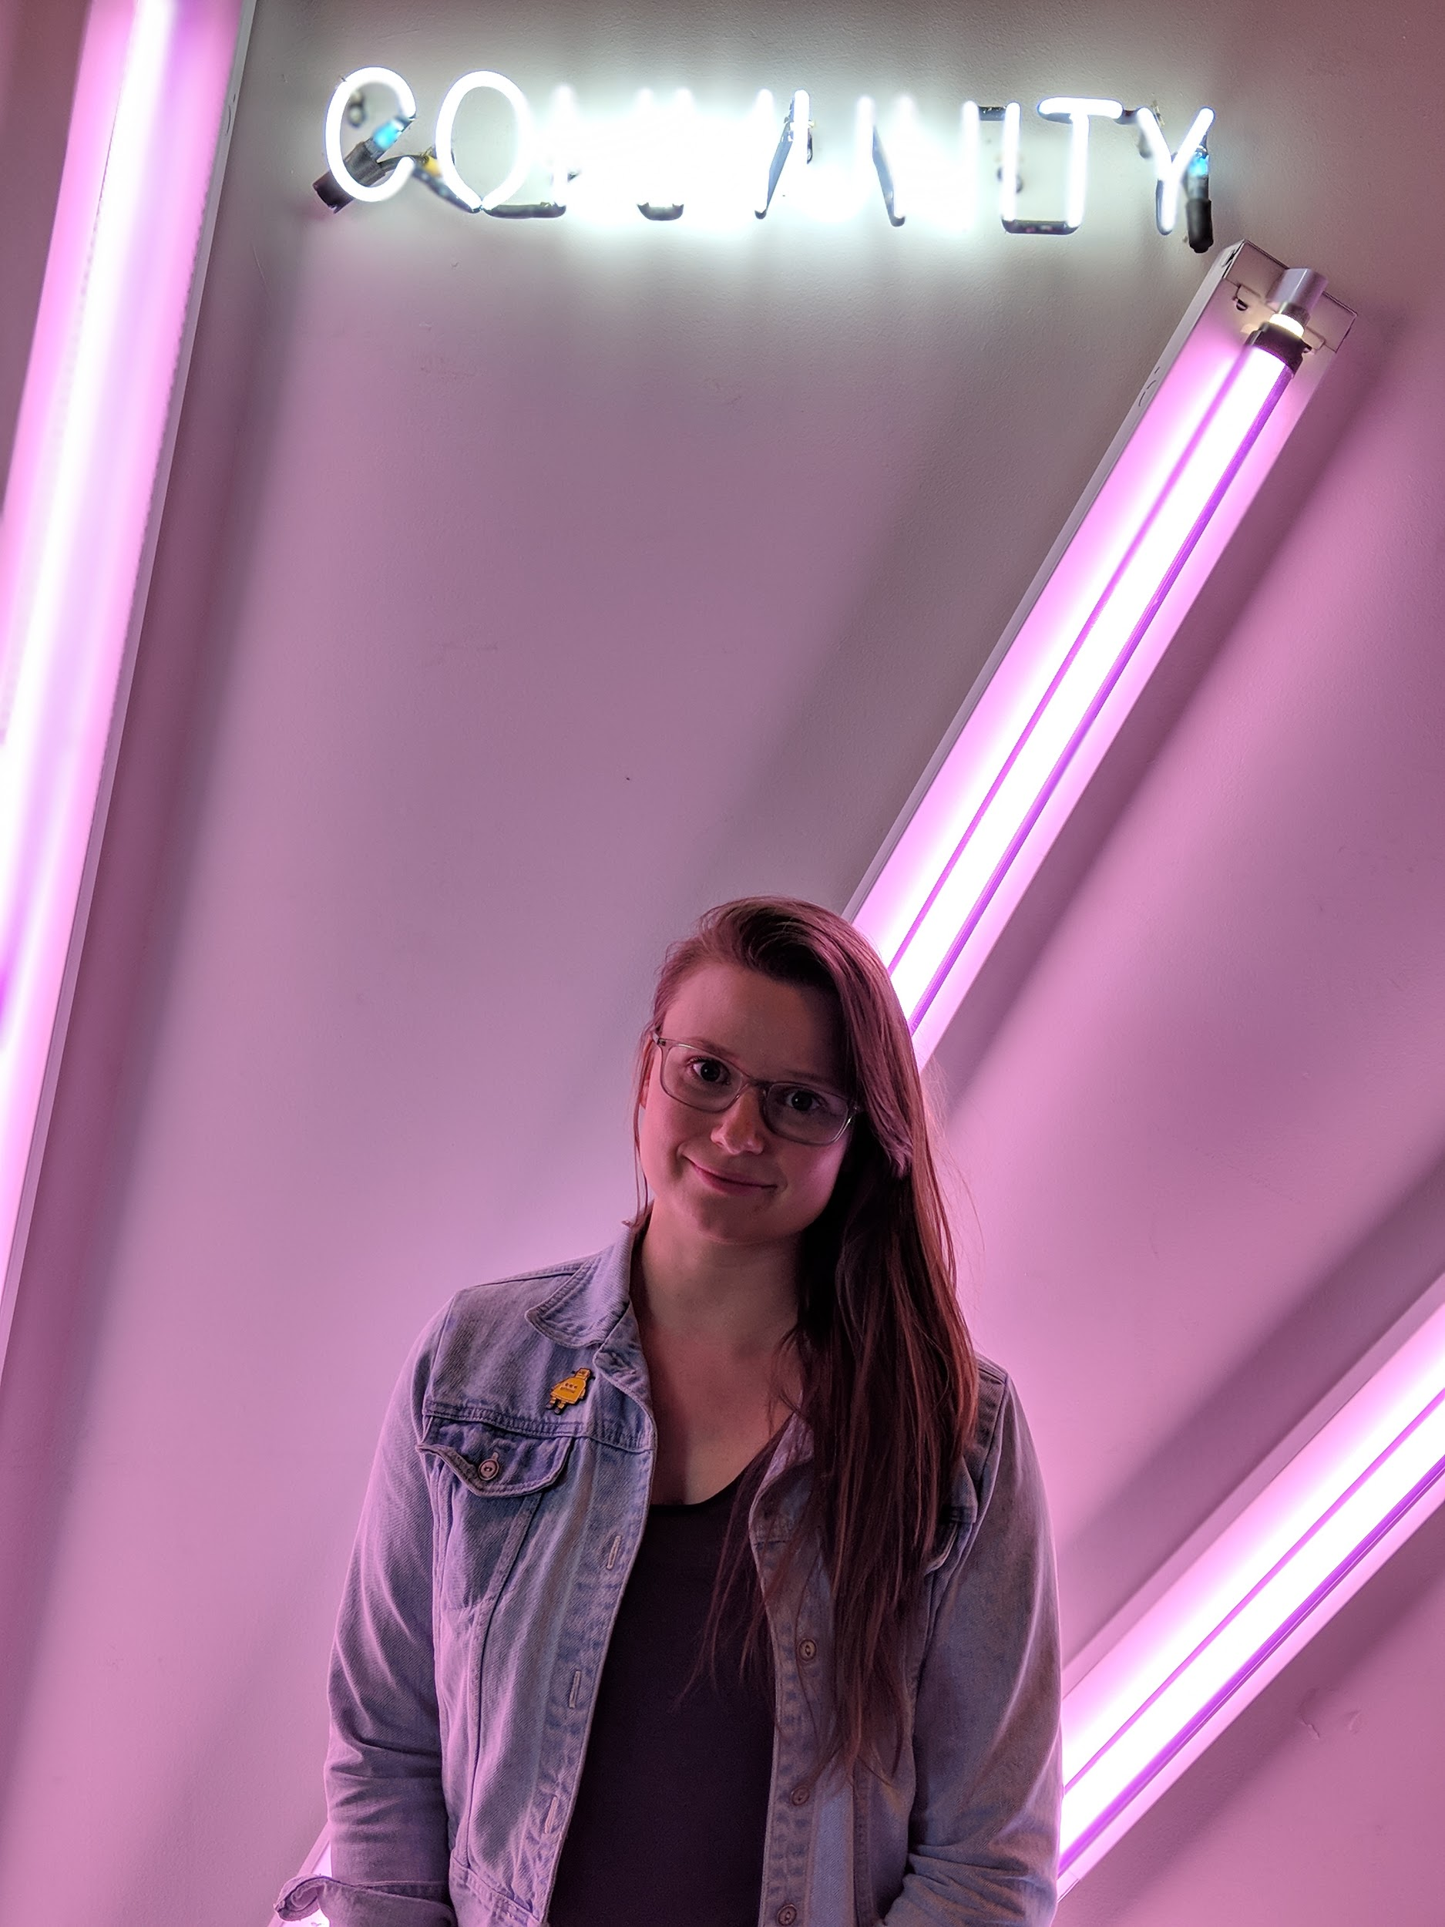
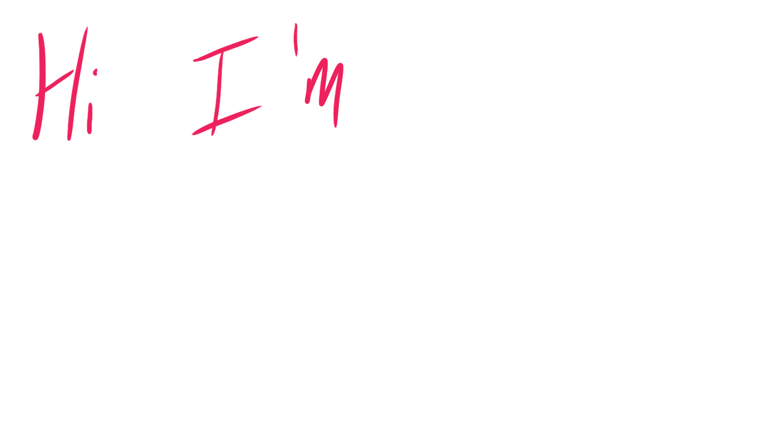
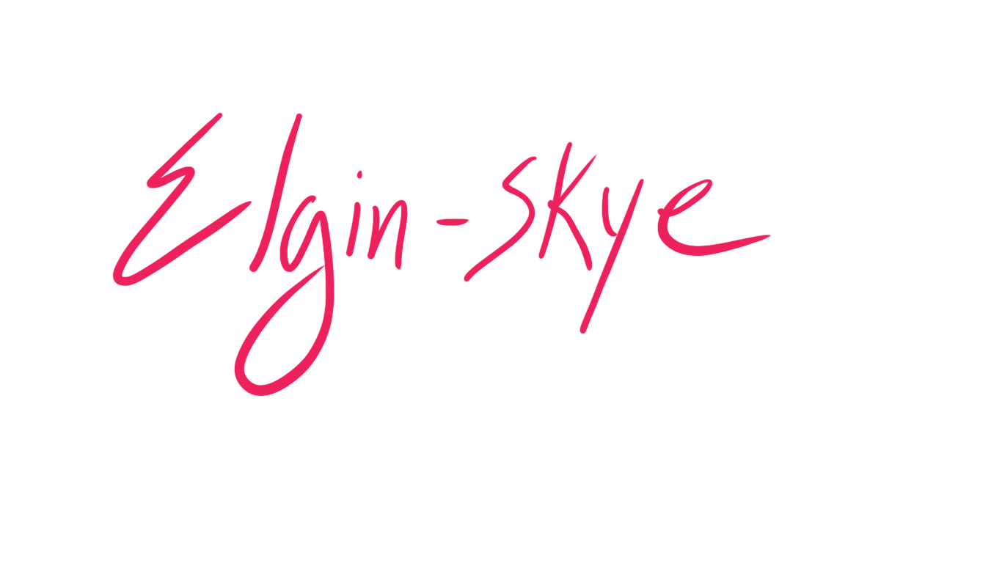
n

Slide 3
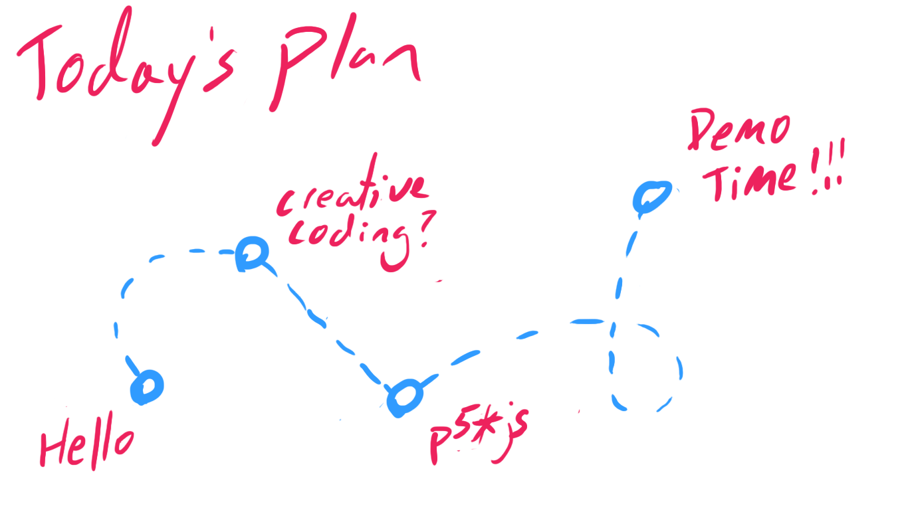

Slide 7

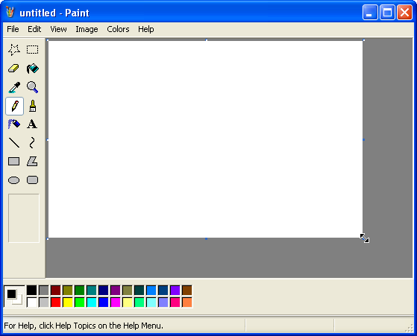
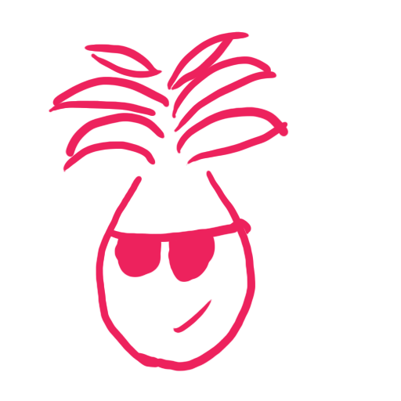

Slide 8

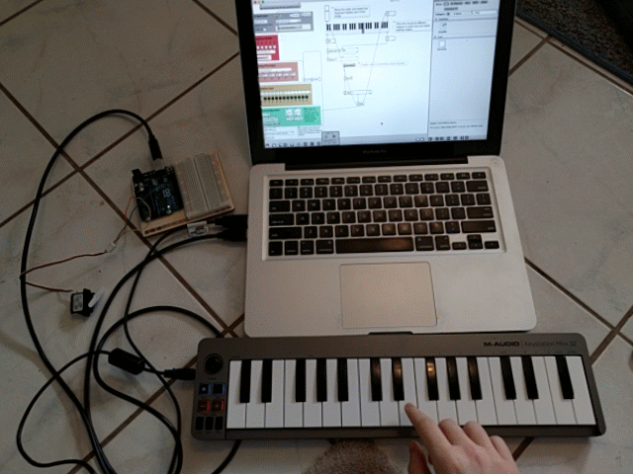

Slide 9
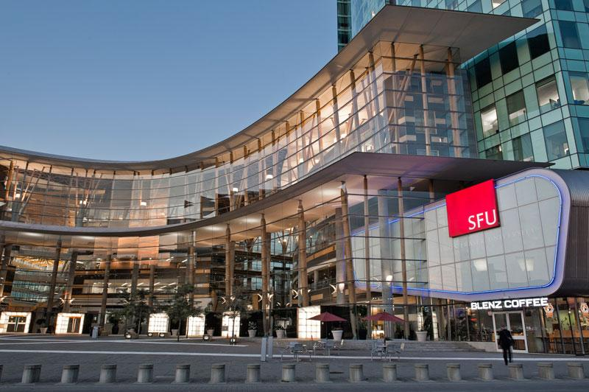
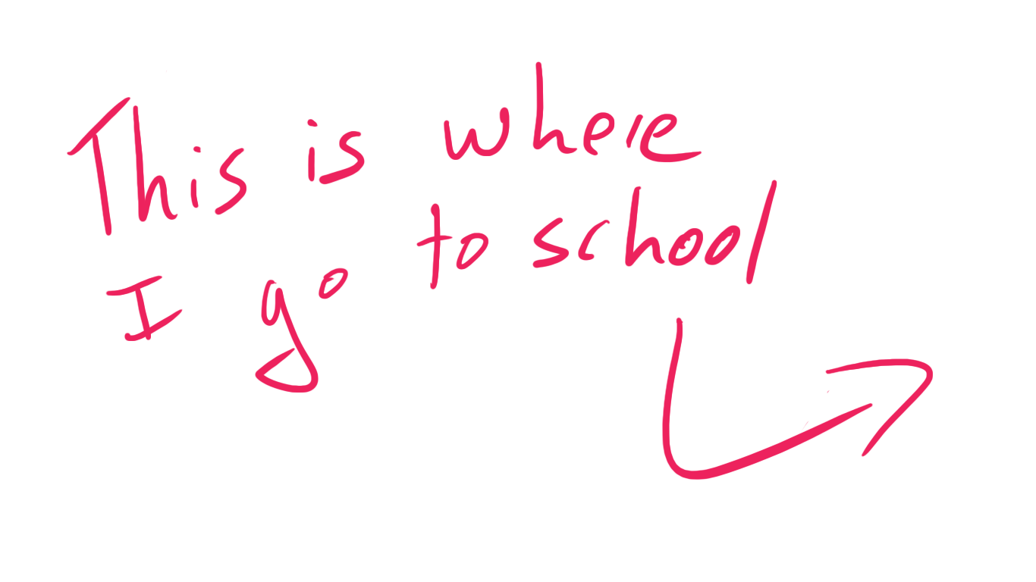

Slide 10
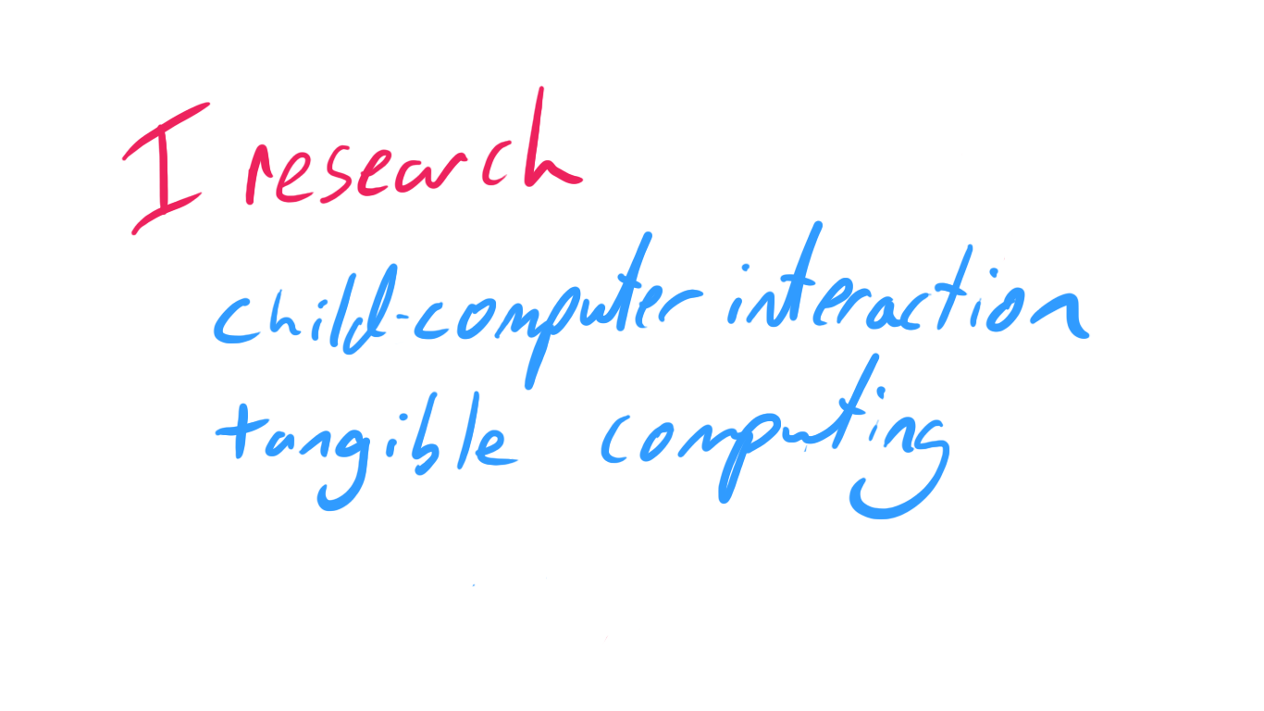

Slide 11
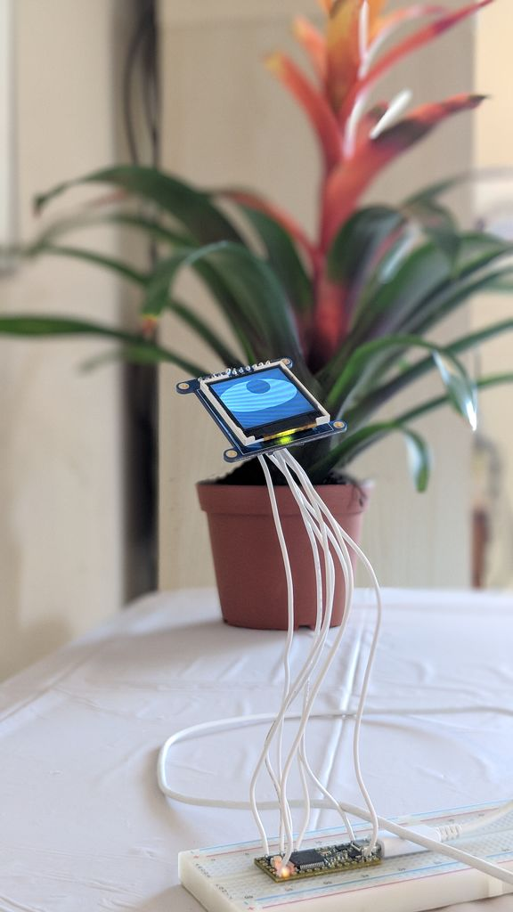
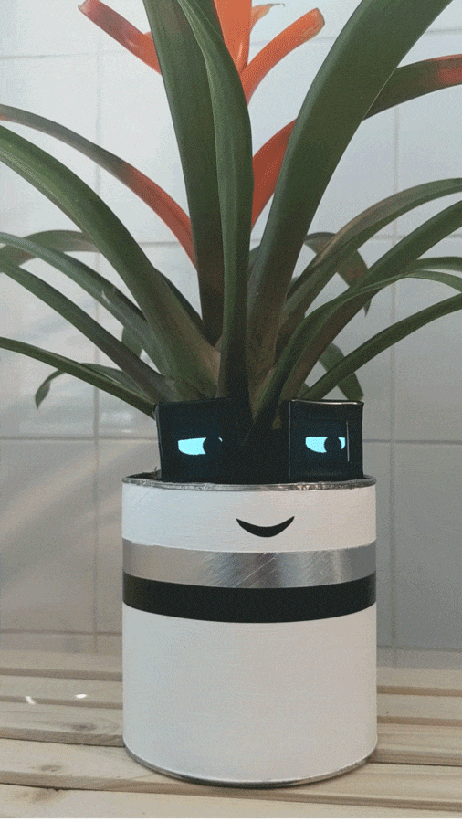
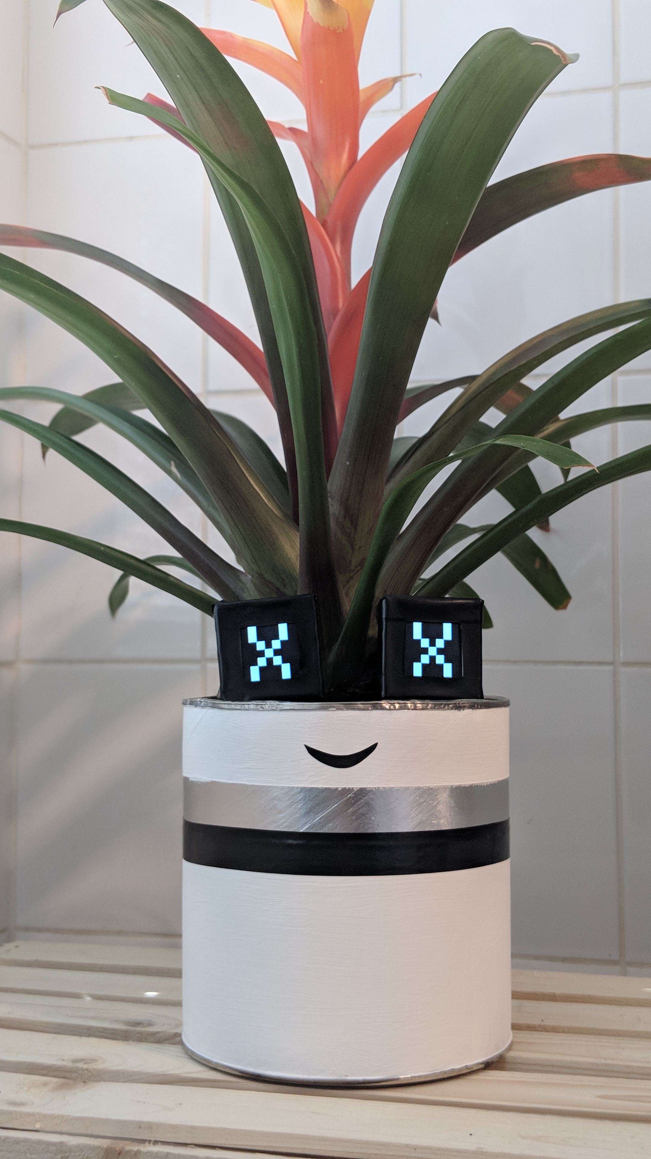

Slide 12
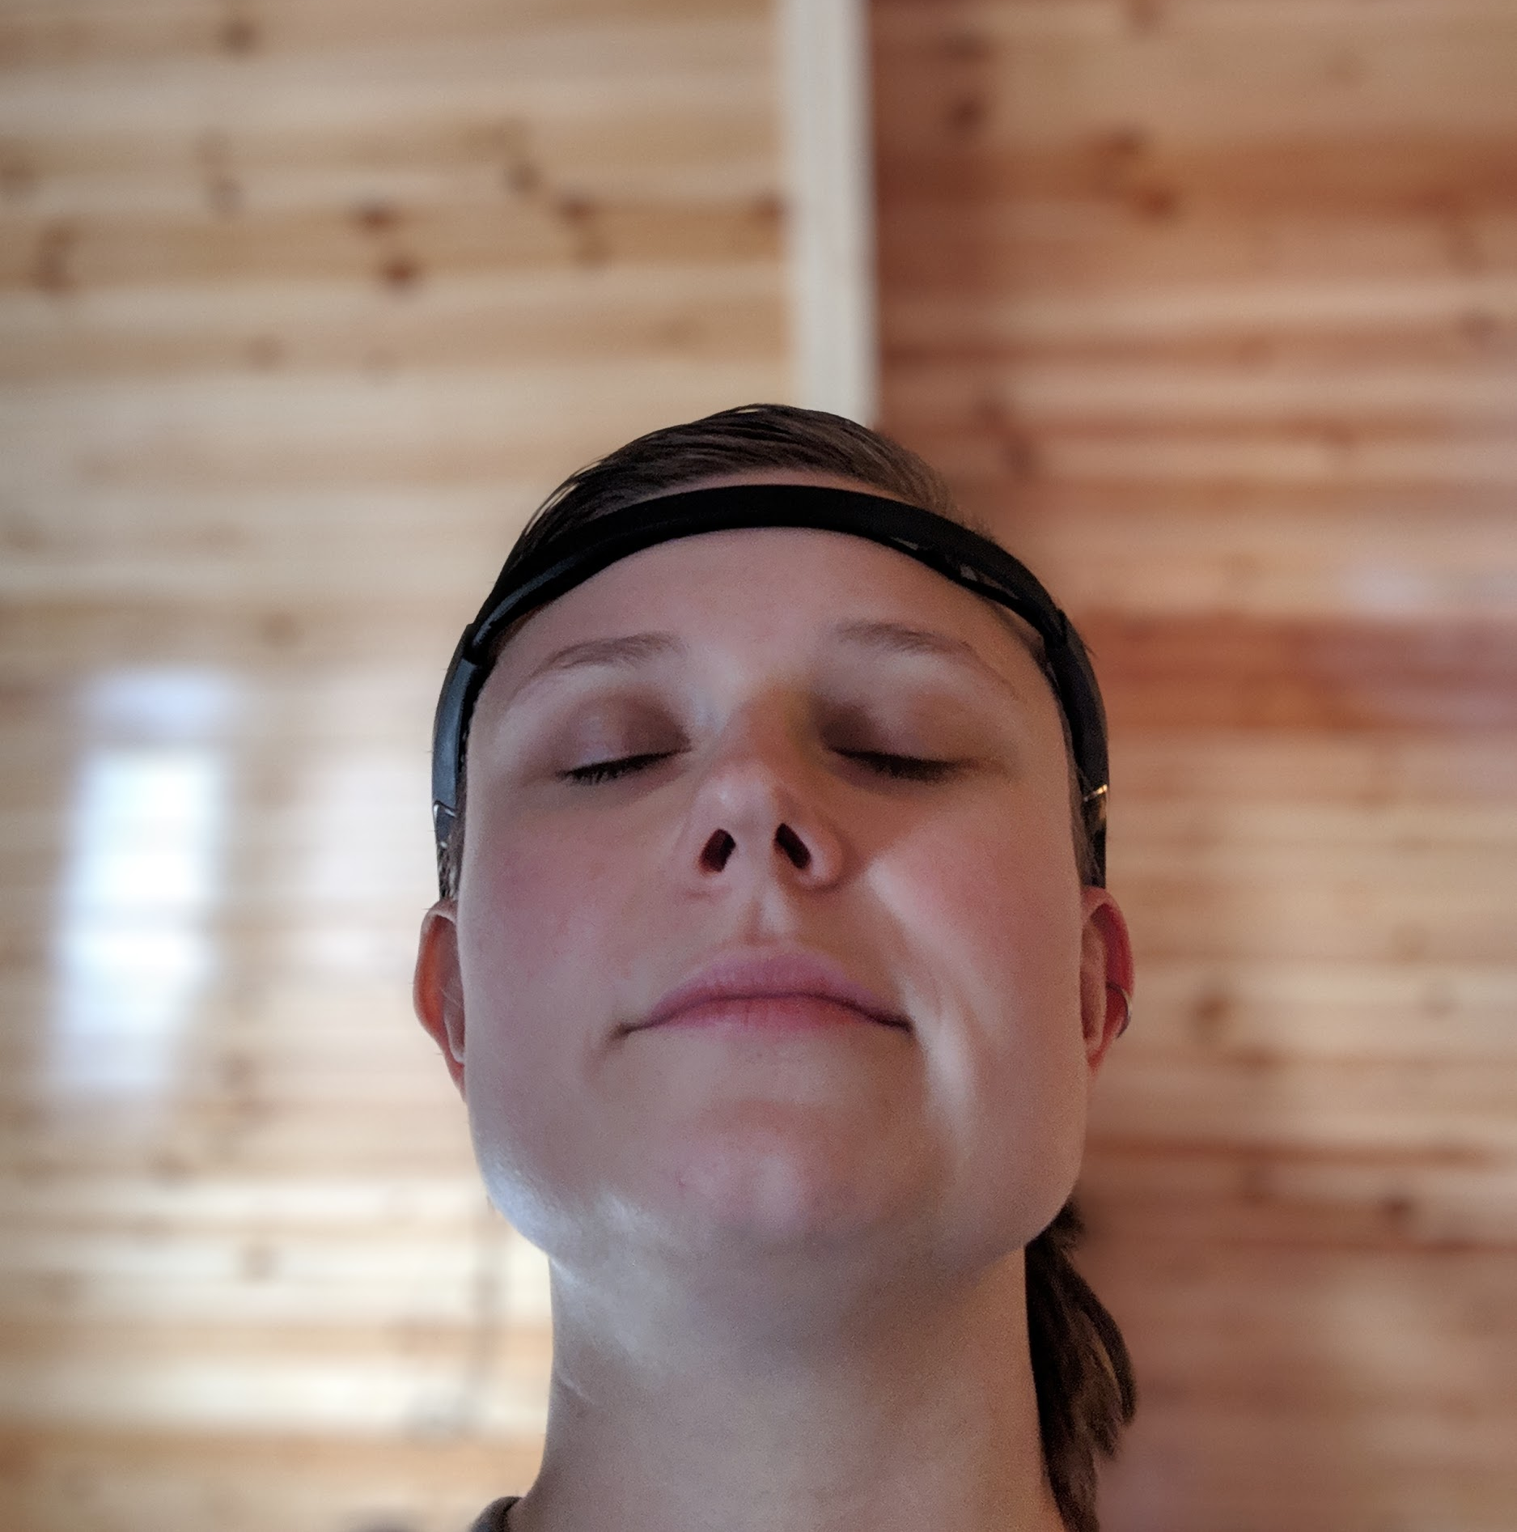
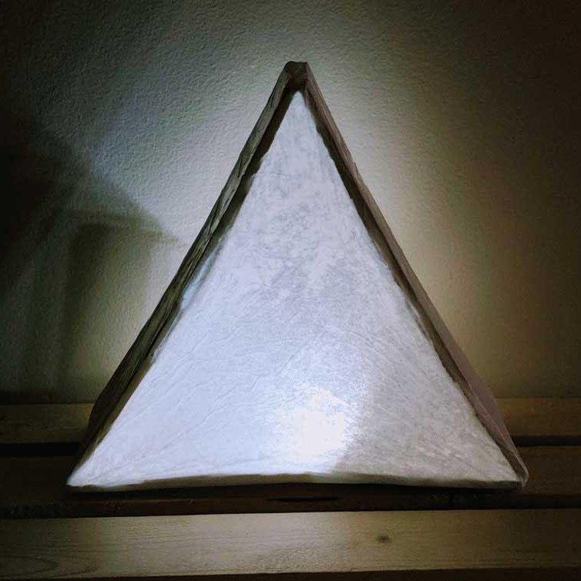
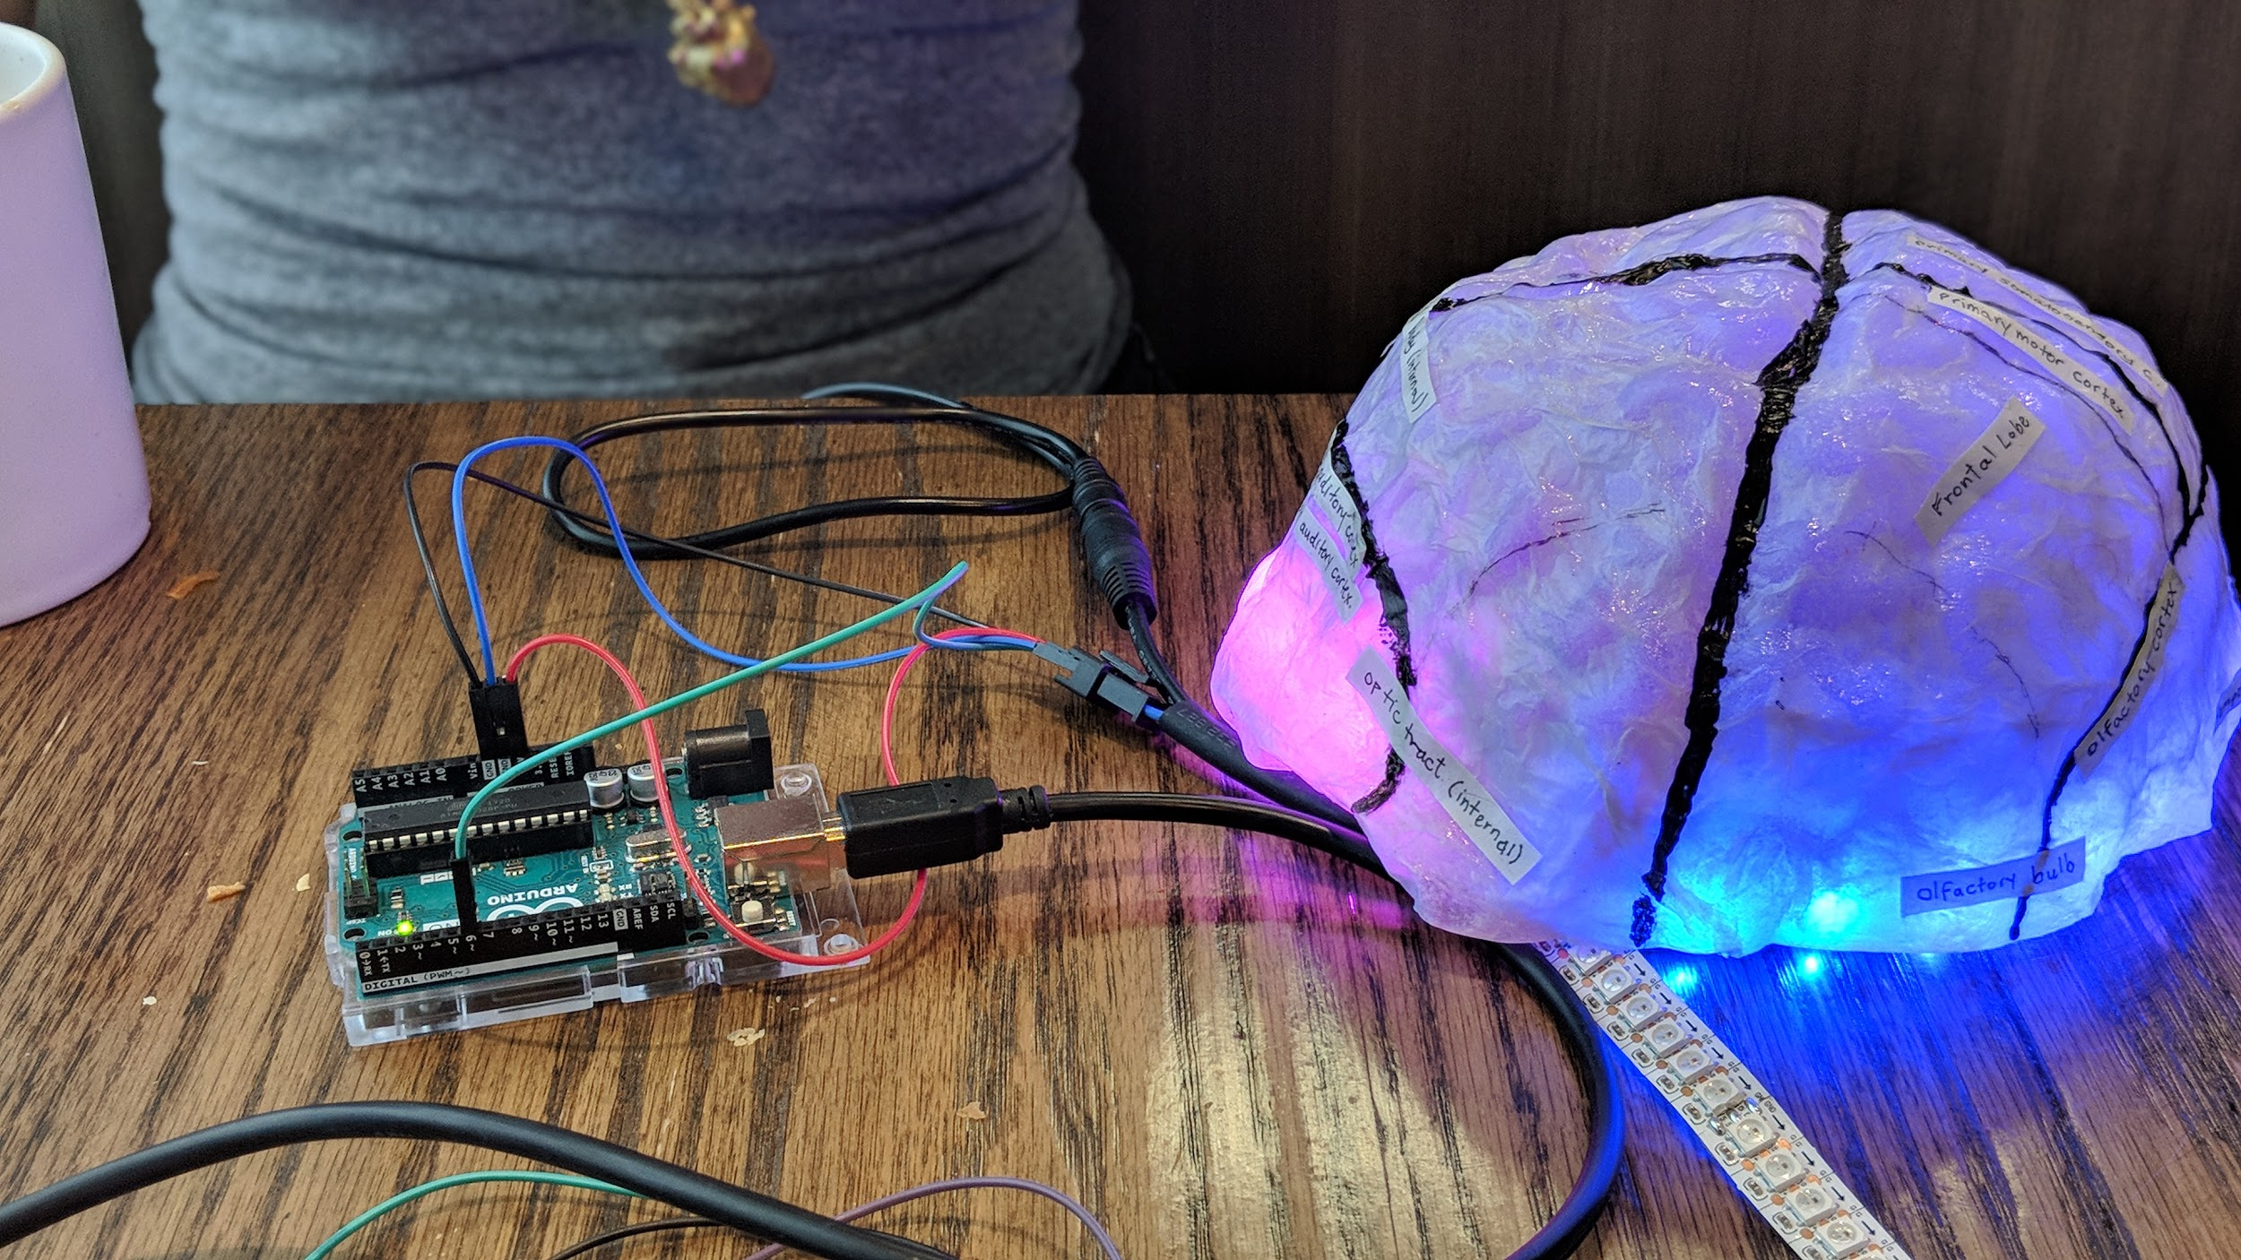
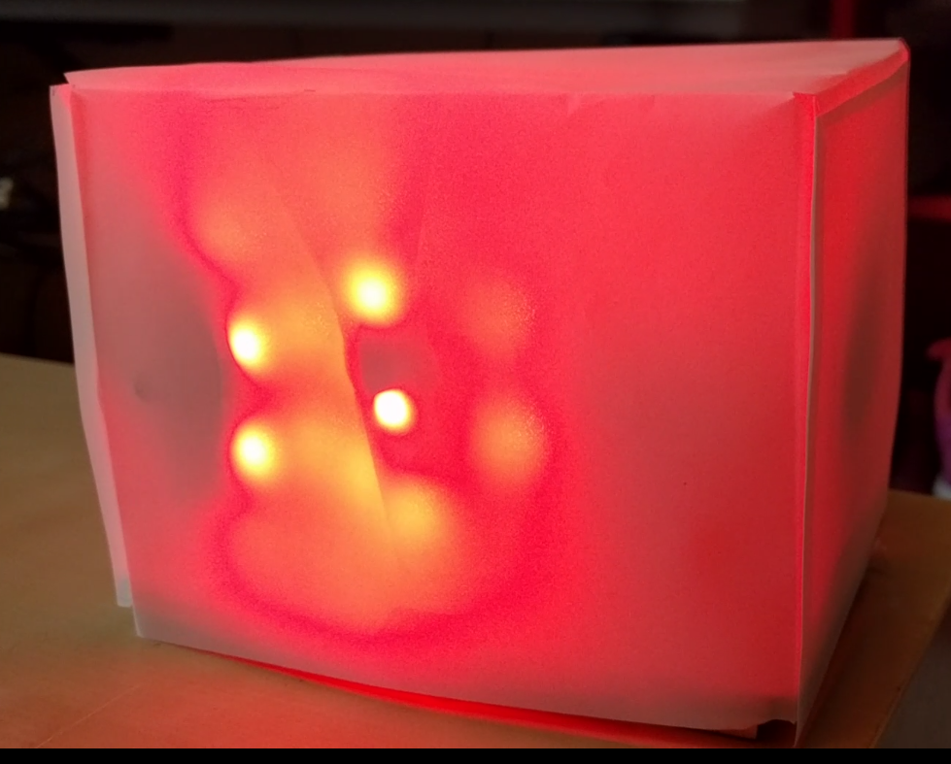

Slide 13

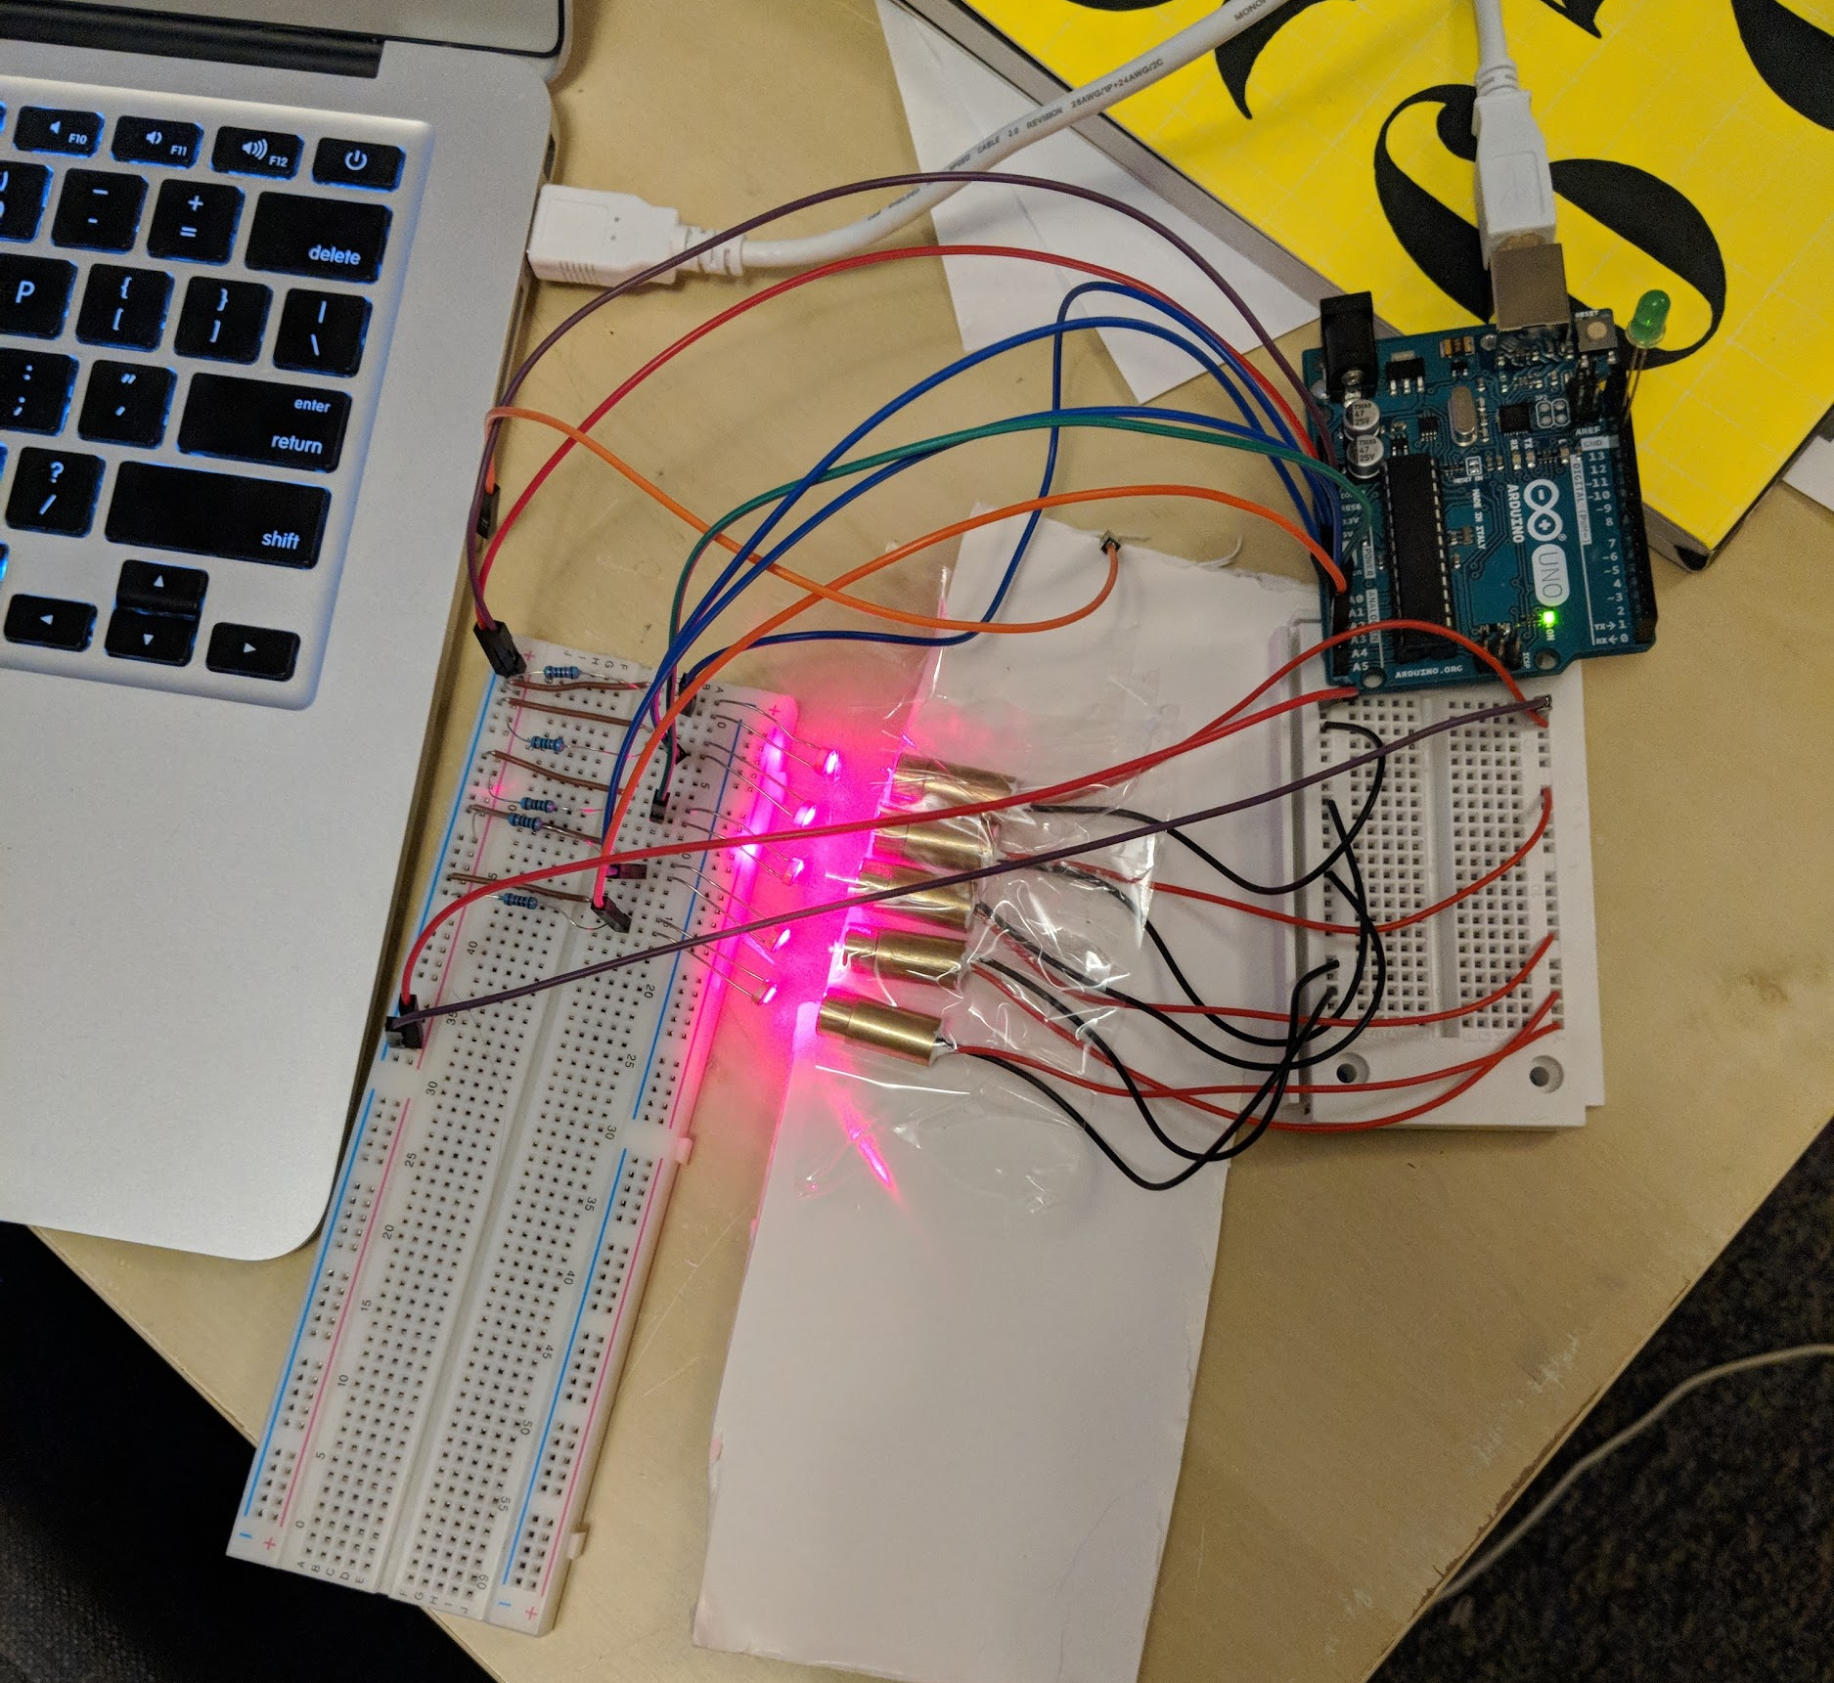

Slide 14


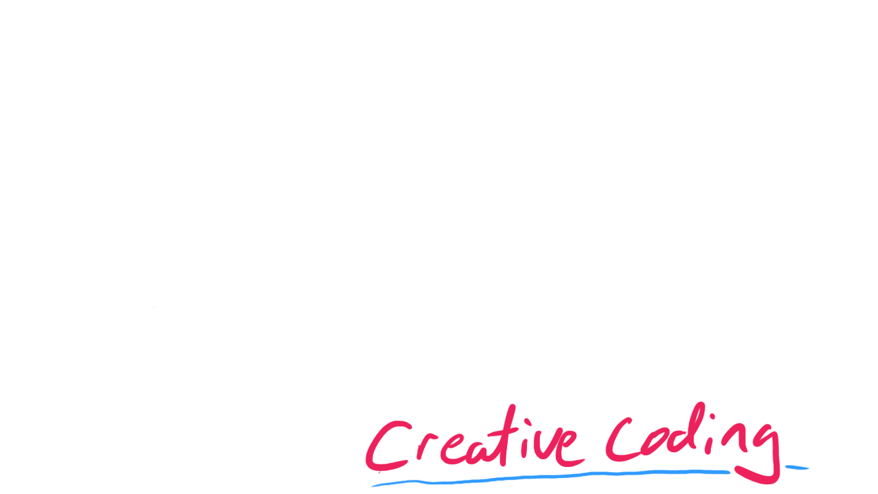
n

Slide 15
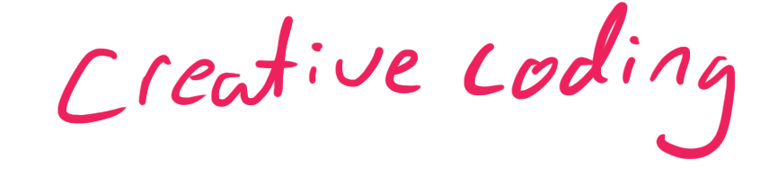

Slide 16
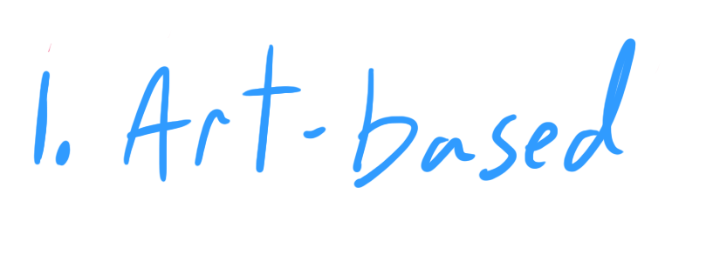

Slide 17
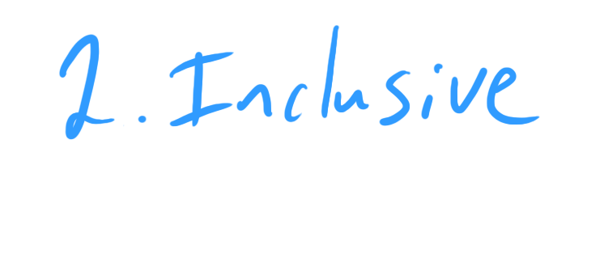

Slide 18



Slide 19
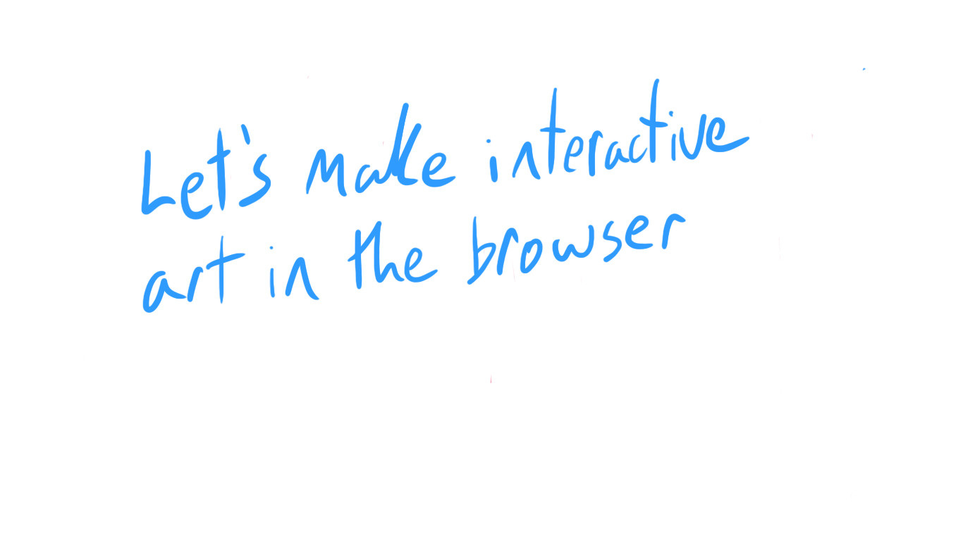
Lets make interactive art in the browser

Slide 20
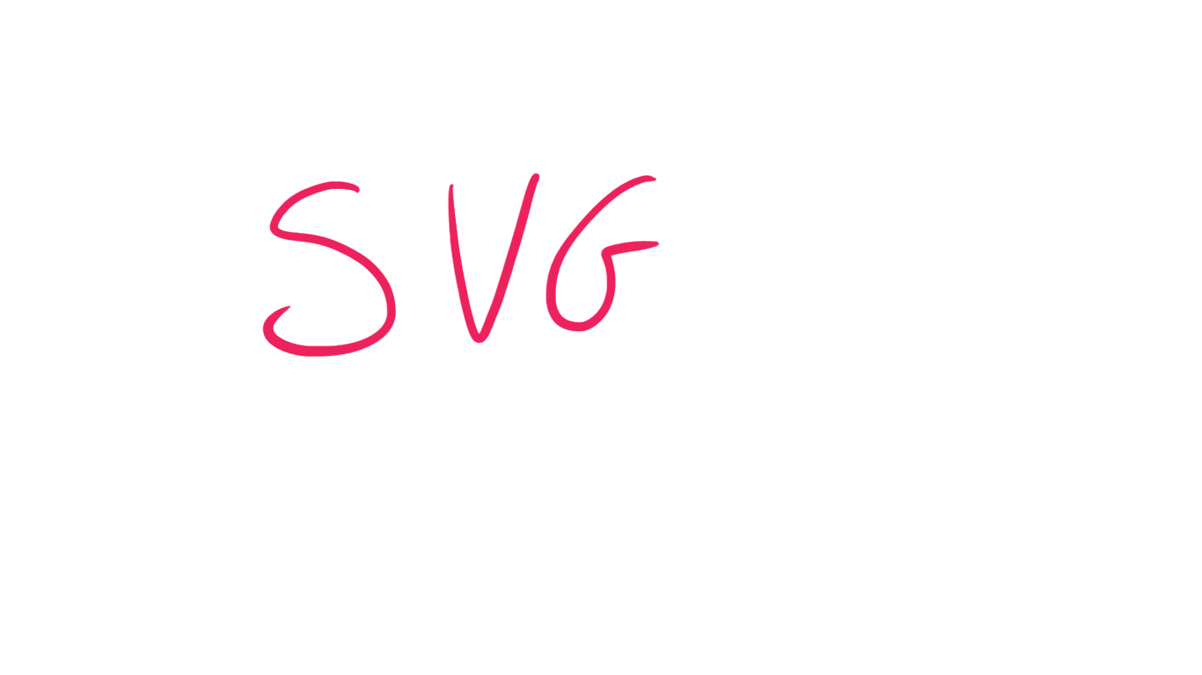
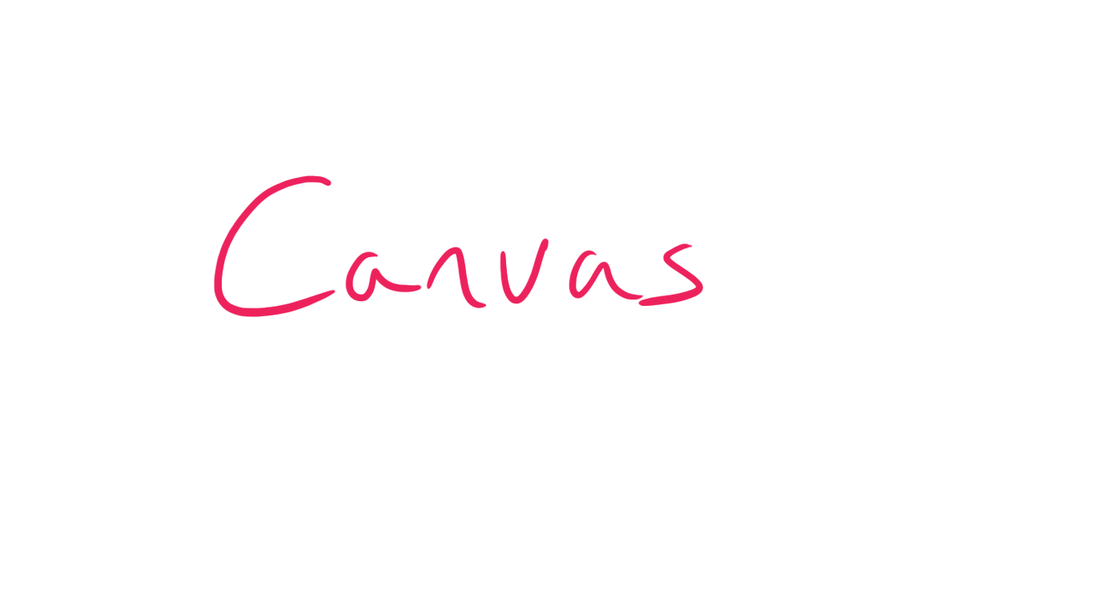
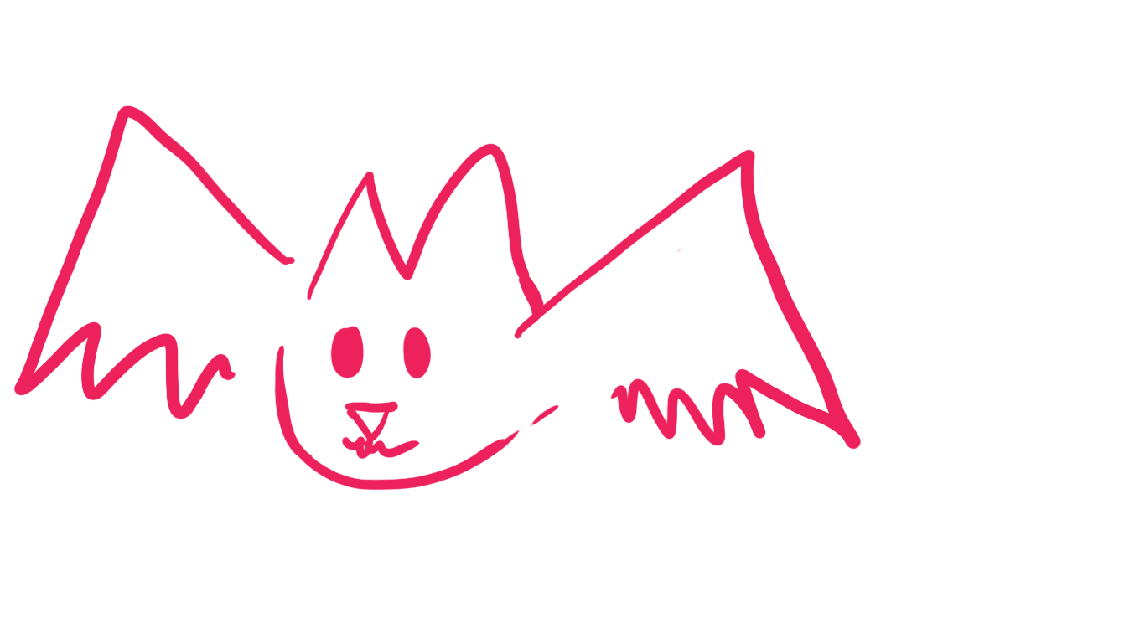
VS

Slide 21
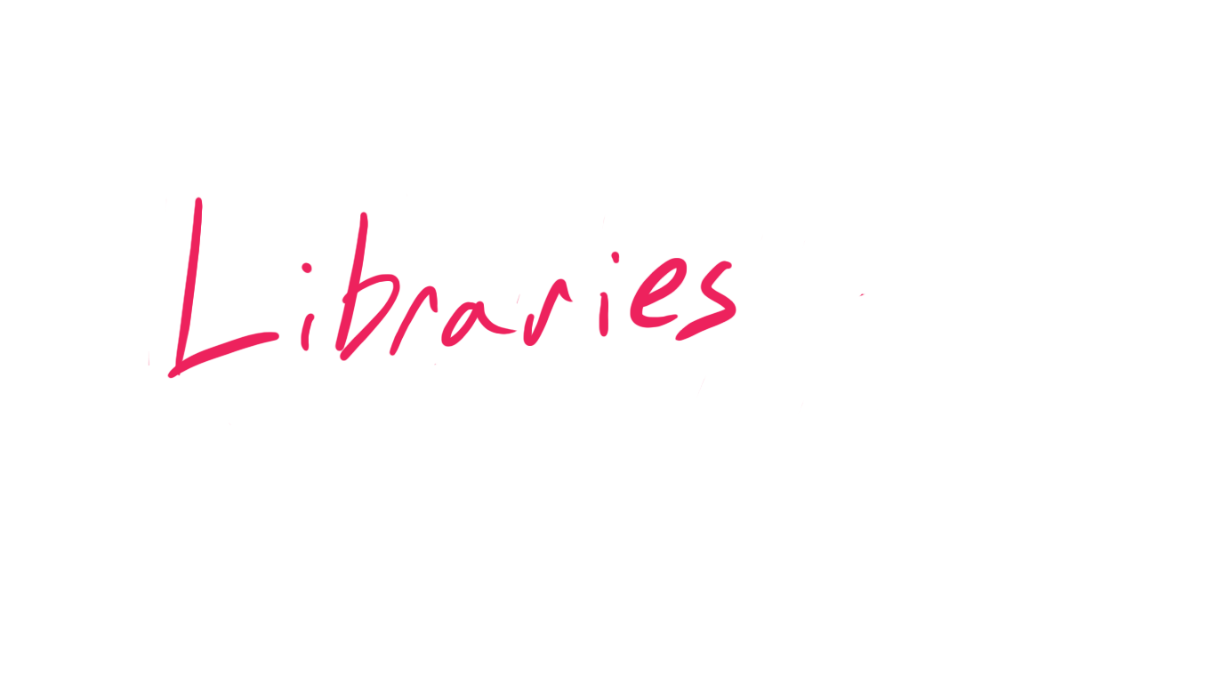

Slide 22
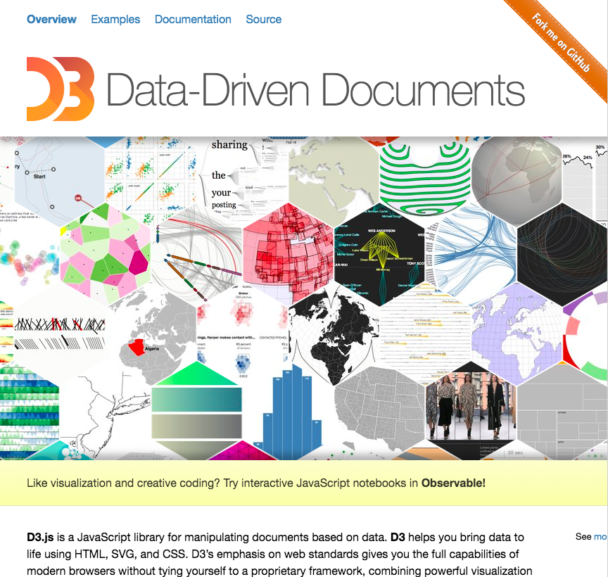
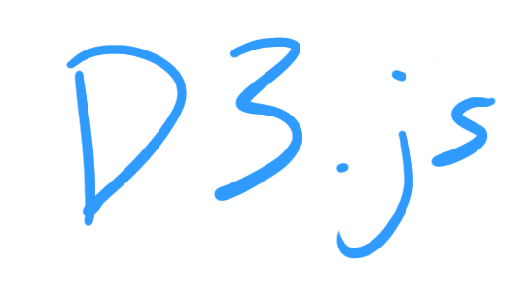

Slide 23
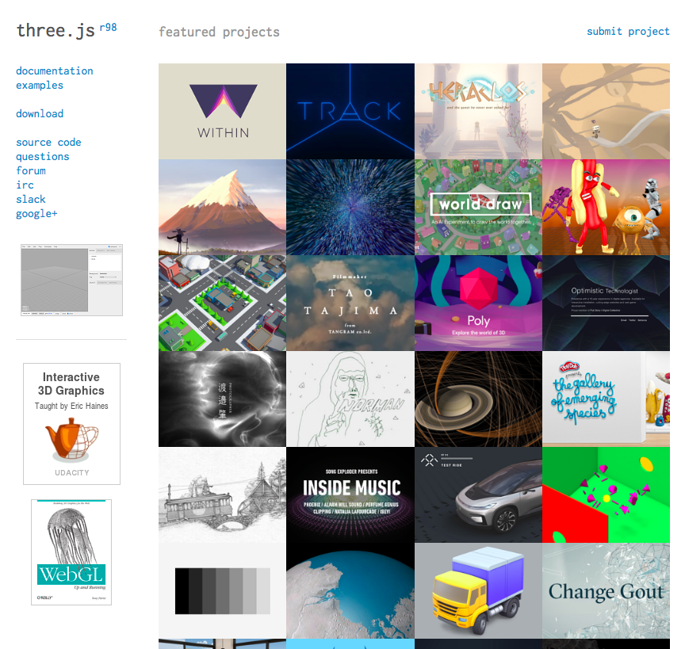
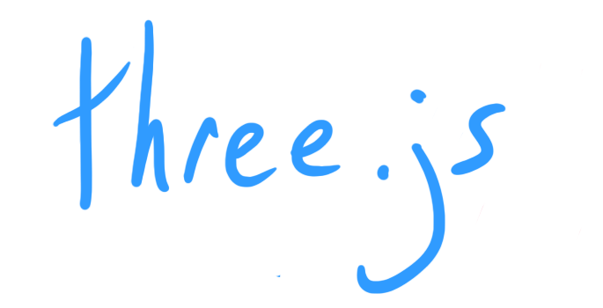

Slide 24

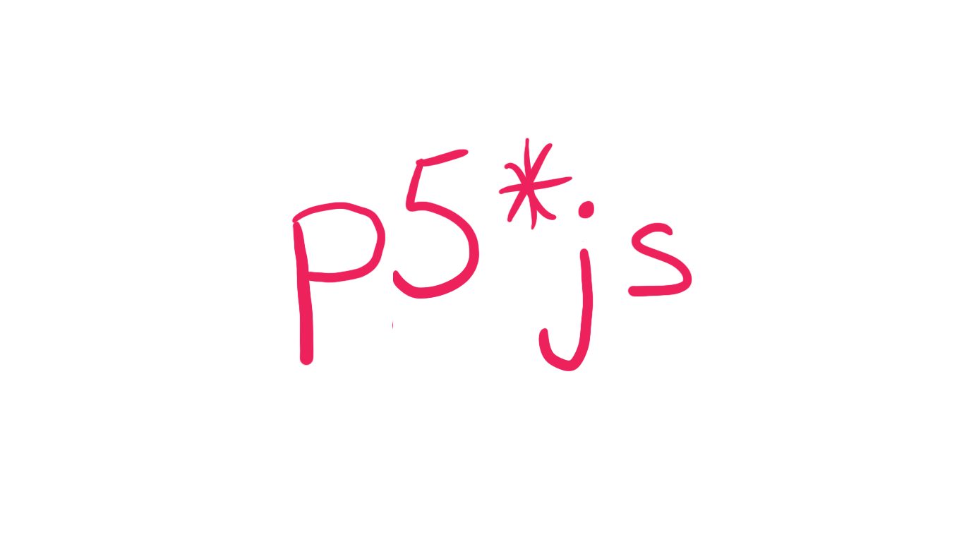

Slide 25

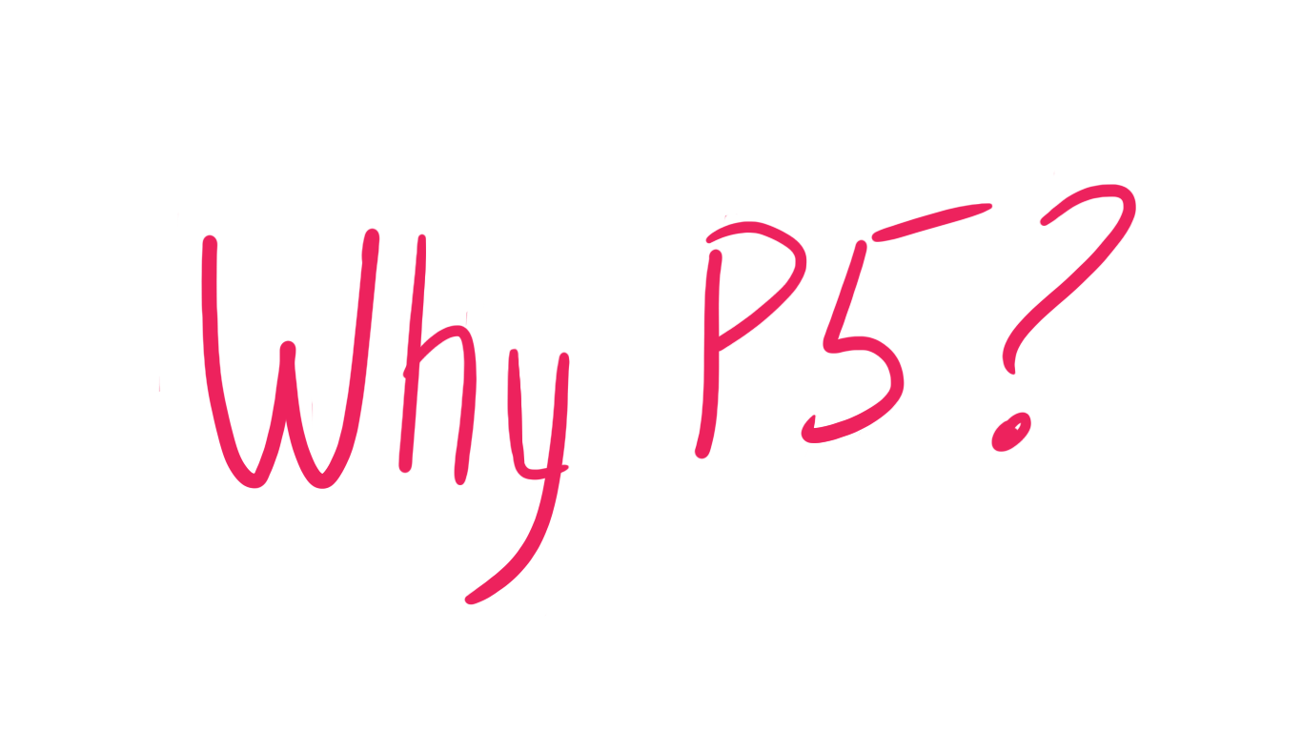

Slide 26





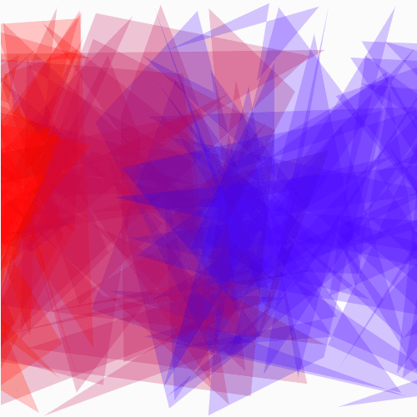


Slide 27
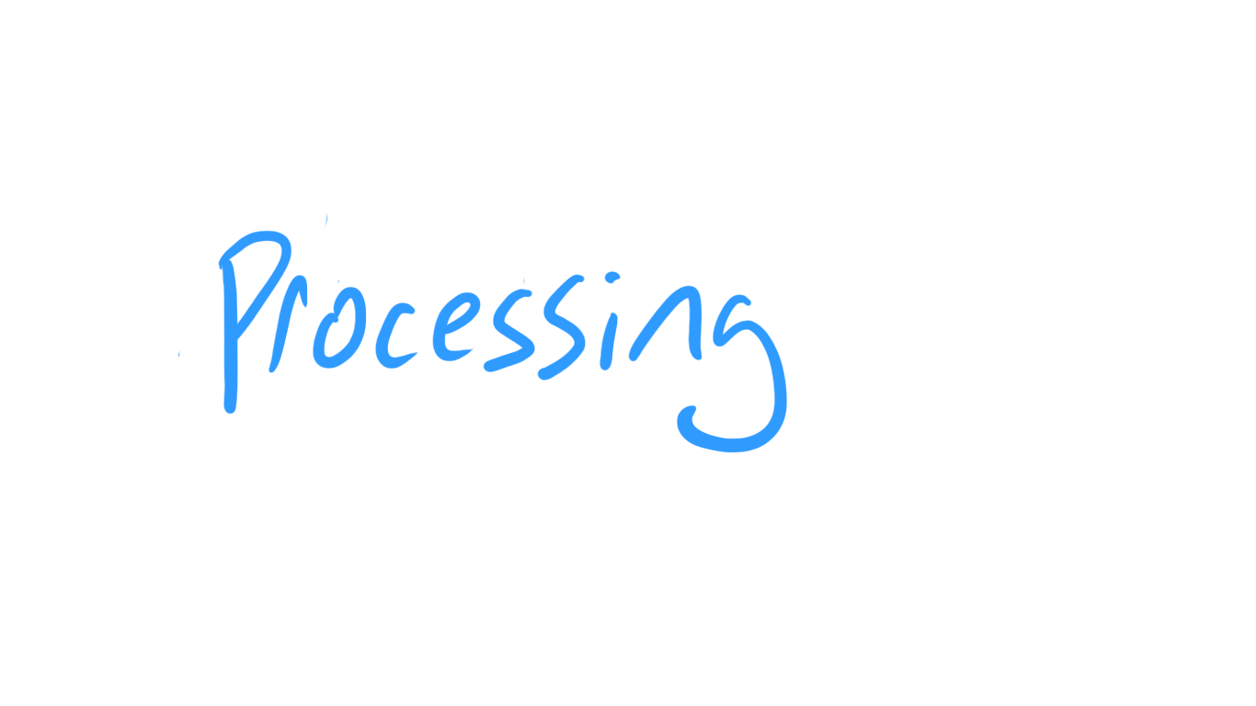
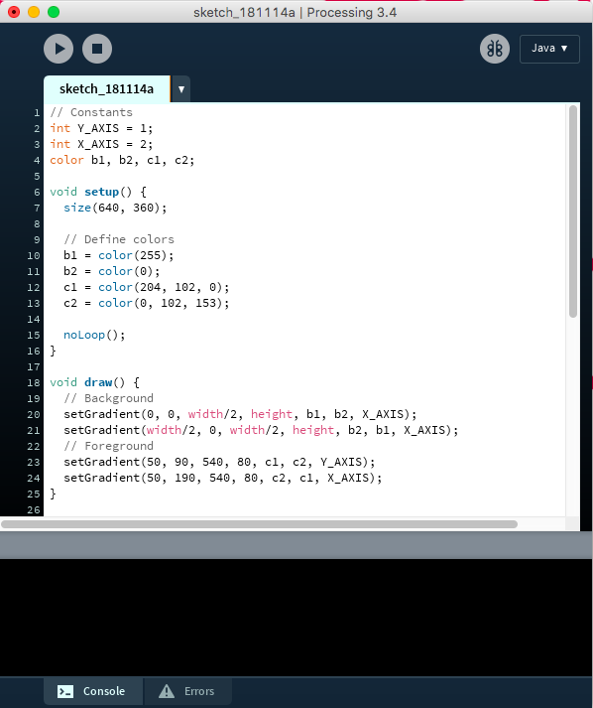

Slide 28
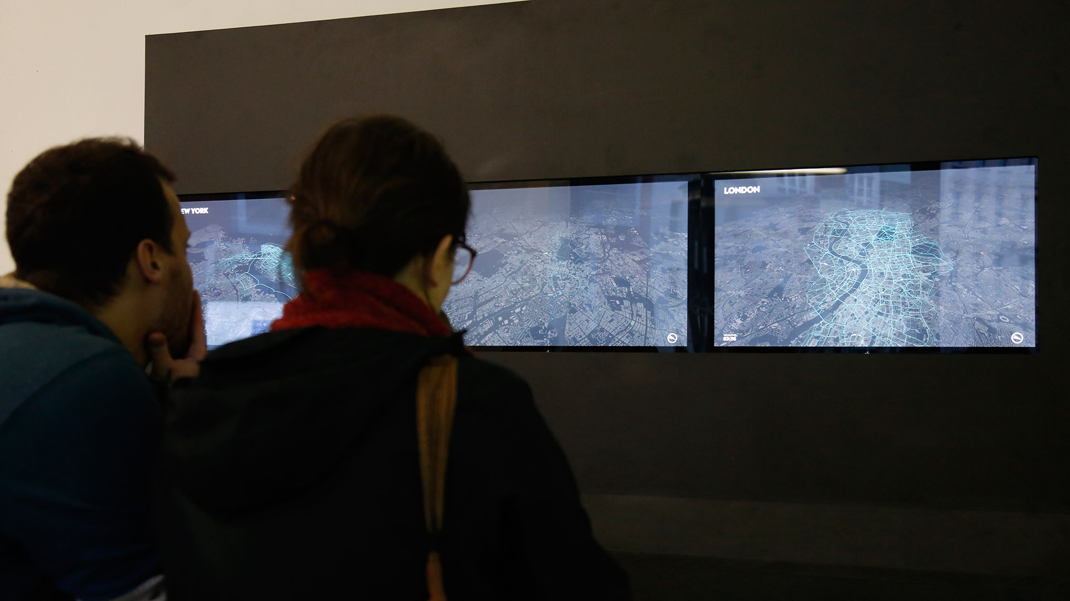
Till Nagel & Christopher Pietsch – CF. Cityflows

Slide 29
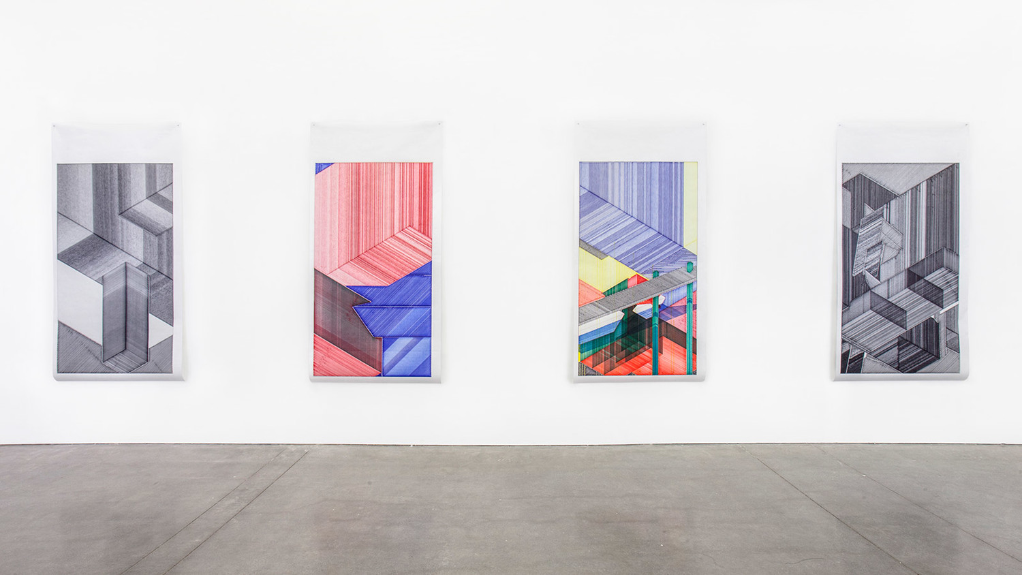
Miguel Nóbrega – Possible, Plausible, Potential
Till Nagel & Christopher Pietsch – CF. Cityflows

Slide 30
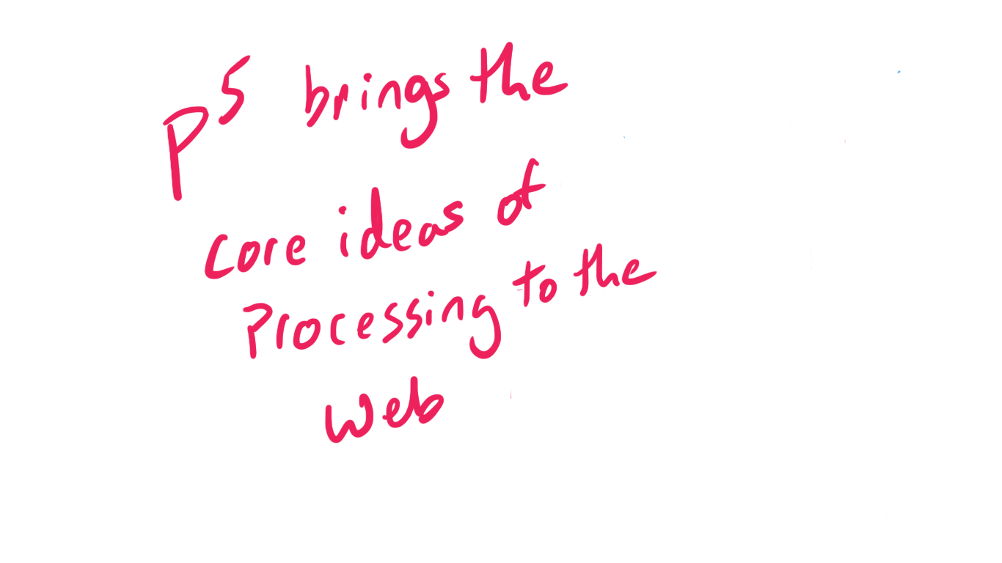

Slide 31
Our mission is to promote software literacy within the visual arts, and visual literacy within technology-related fields — and to make these fields accessible to diverse communities. Our goal is to empower people of all interests and backgrounds to learn how to program and make creative work with code, especially those who might not otherwise have access to these tools and resources.

Slide 32
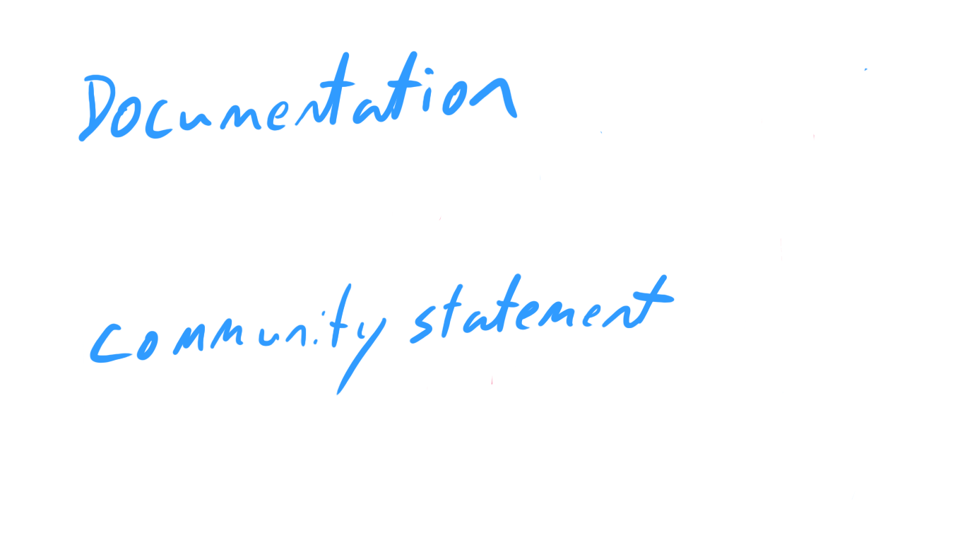

Slide 33
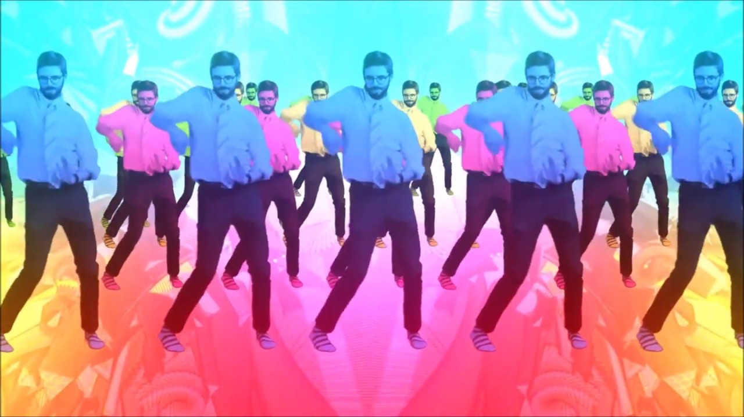
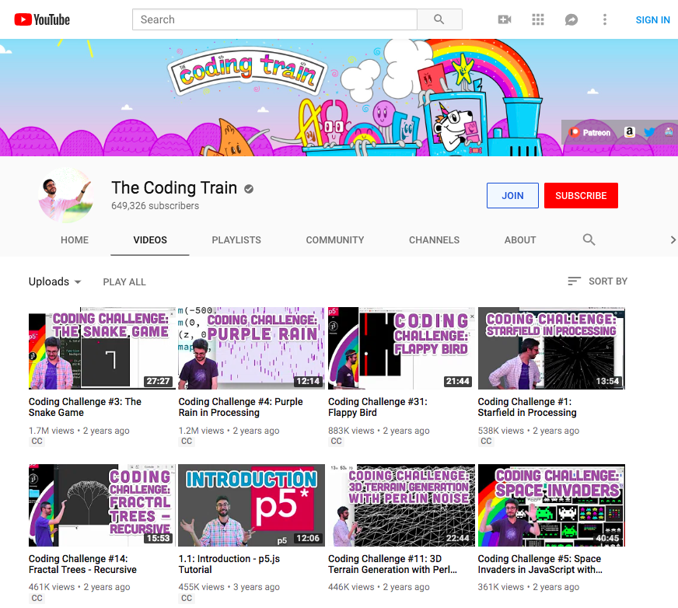

Slide 35
p5.js is a community interested in exploring the creation of art and design with technology.
We are a community of, and in solidarity with, people from every gender identity and expression, sexual orientation, race, ethnicity, language, neuro-type, size, ability, class, religion, culture, subculture, political opinion, age, skill level, occupation, and background. We acknowledge that not everyone has the time, financial means, or capacity to actively participate, but we recognize and encourage involvement of all kinds. We facilitate and foster access and empowerment. We are all learners.
We like these hashtags: #noCodeSnobs (because we value community over efficiency), #newKidLove (because we all started somewhere), #unassumeCore (because we don't assume knowledge), and #BlackLivesMatter (because of course).
In practice:
We are not code snobs. We do not assume knowledge or imply there are things that somebody should know.
We insist on actively engaging with requests for feedback regardless of their complexity.
We welcome newcomers and prioritize the education of others. We strive to approach all tasks with the enthusiasm of a newcomer. Because we believe that newcomers are just as valuable in this effort as experts.
We consistently make the effort to actively recognize and validate multiple types of contributions.
We are always willing to offer help or guidance.
In times of conflict:
We listen.
We clearly communicate while acknowledging other's feelings.
We admit when we're wrong, apologize, and accept responsibility for our actions.
We are continuously seeking to improve ourselves and our community.
We keep our community respectful and open.
We make everyone feel heard.
We are mindful and kind in our interactions.

Slide 36
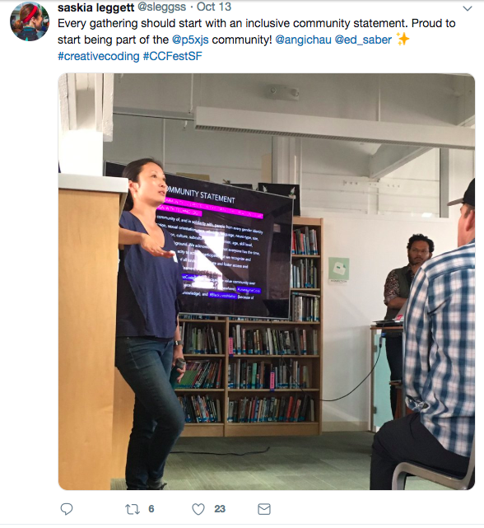
Images from Twitter // lauren-mccarthy.com

Slide 37


Slide 38

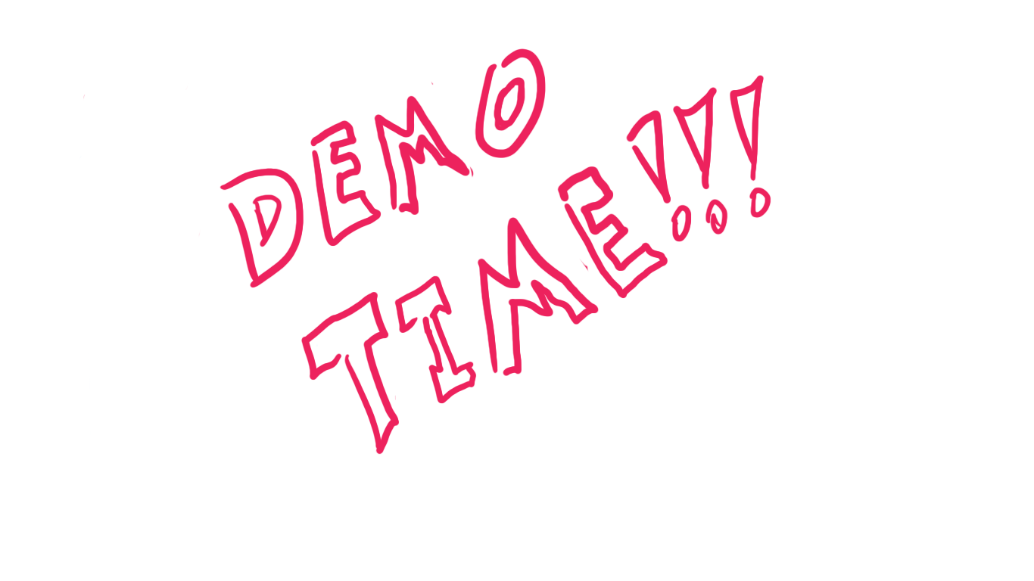

Slide 39
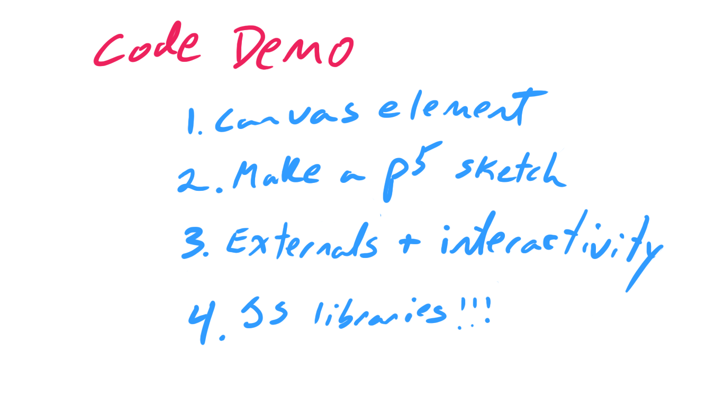

Slide 43
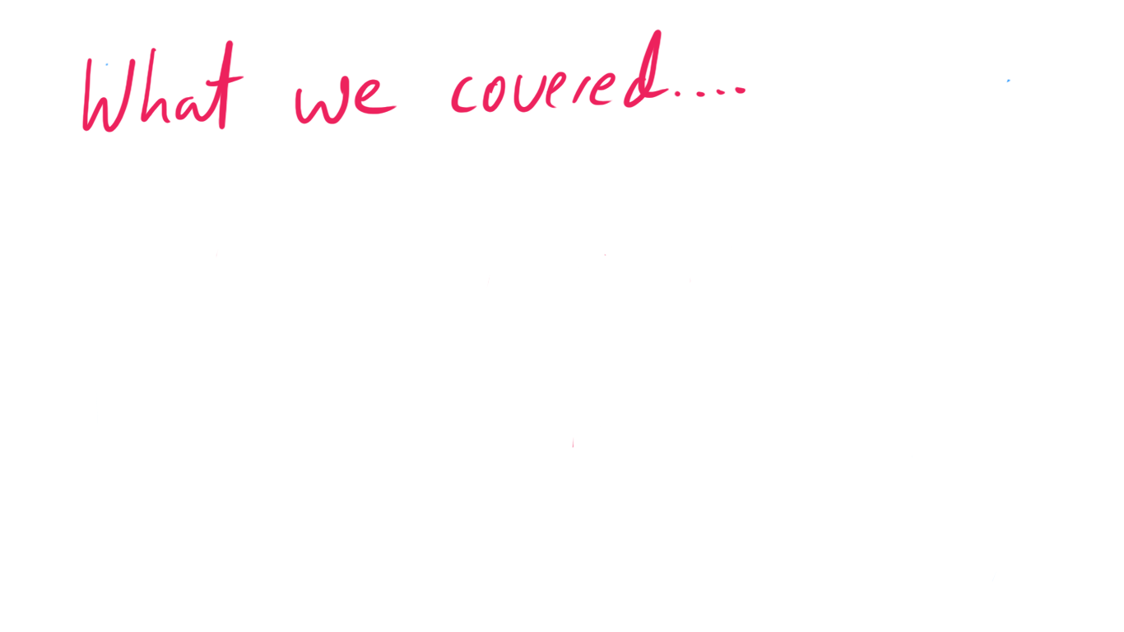


Slide 44

https://editor.p5js.org/
https://p5js.org/reference/

Slide 45

https://editor.p5js.org/
https://p5js.org/reference/
https://ml5js.org/

Slide 46

https://editor.p5js.org/

Slide 47

https://editor.p5js.org/

Slide 48

https://editor.p5js.org/

